Slide 1
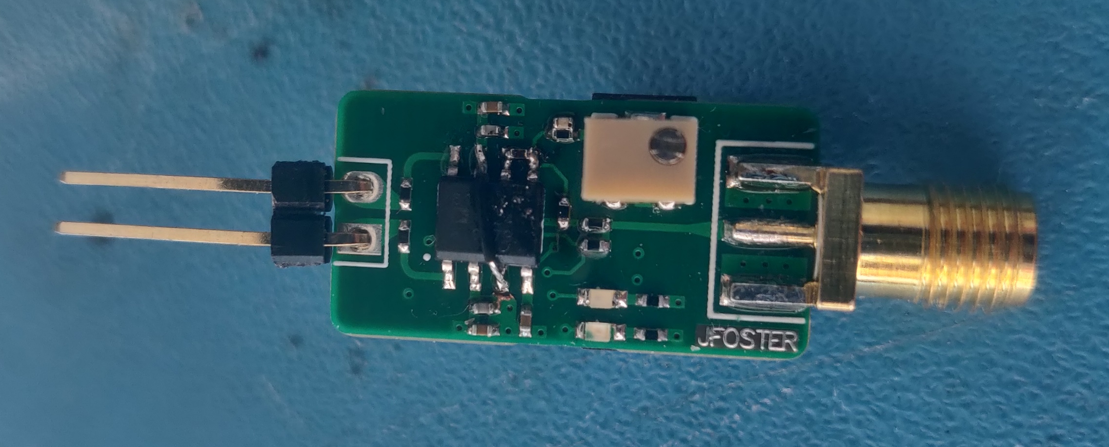
Mod #2
Mod #3
DC Offset Adjust
Differential Input
Mod #1
SMA Output
DC Offset Indicators
Mod #1: Cut pin 3 track to GND, solder it to +VS, this is the PD pin.
Mod #2: Add 1.2 pF between OUT and FB of the amplifier.
Mod #3: Add 12-22 pF (can’t remember exactly) between FB and REF pins of the amplifier.

Slide 2
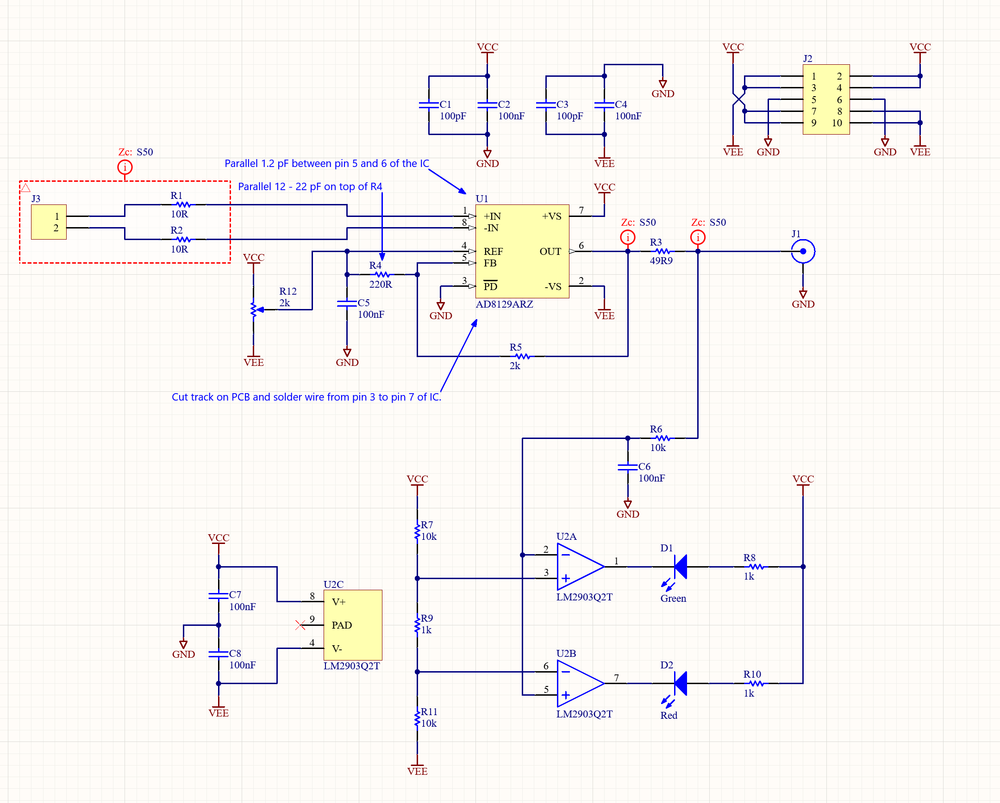
Probe Schematic

Slide 3
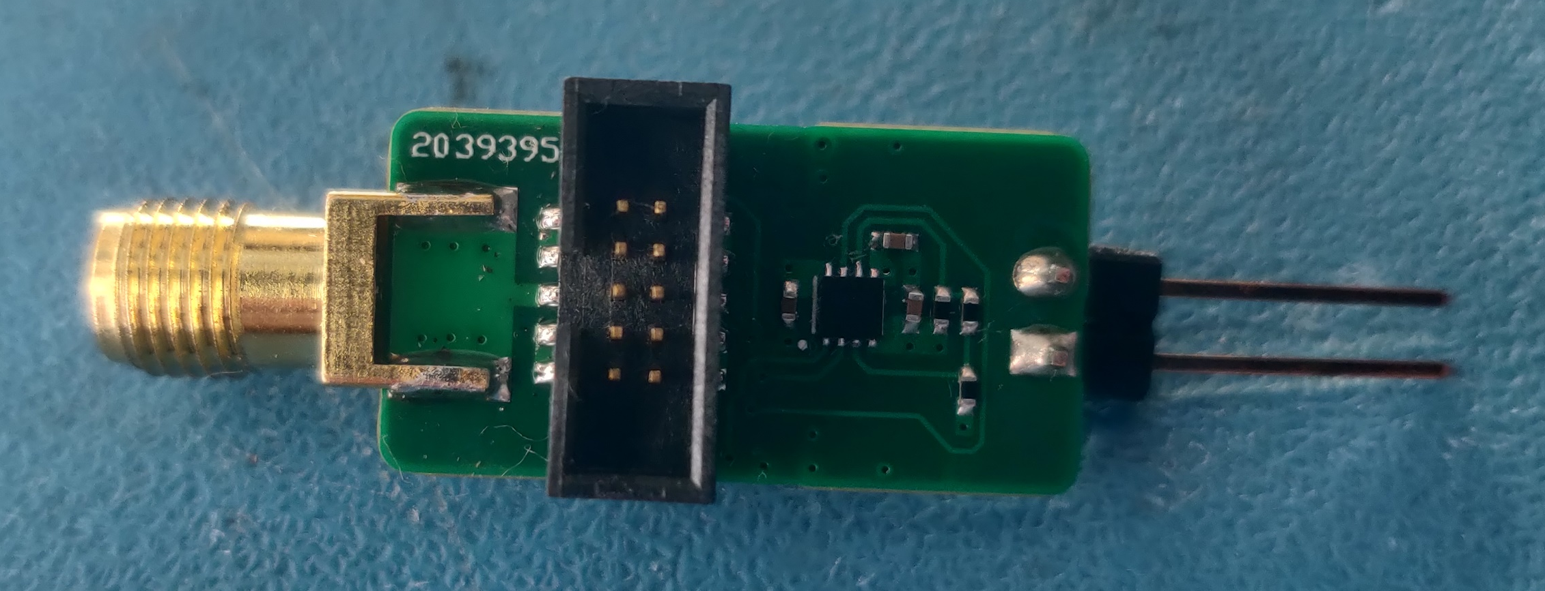
Probe Power (up to ±12V)

Slide 4
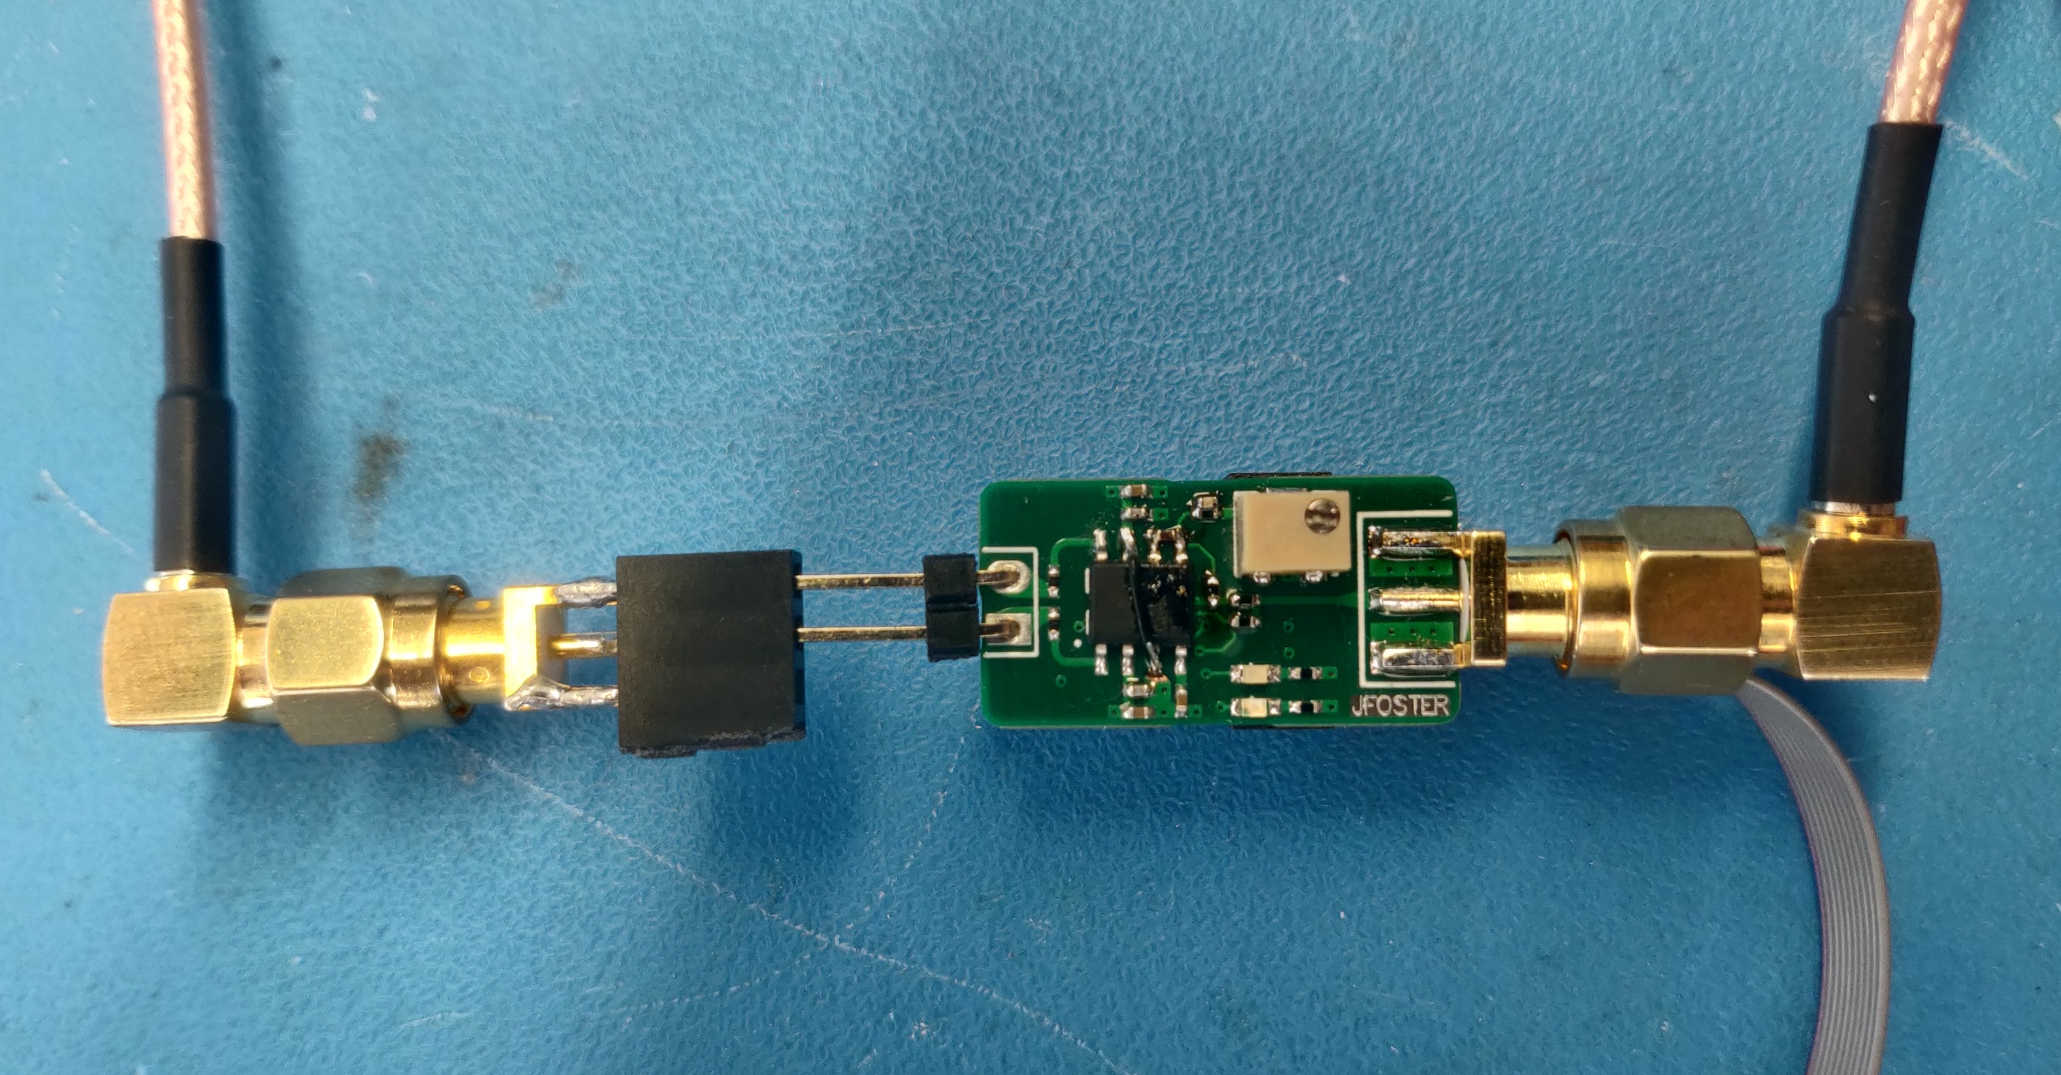
Measurement Setup for Differential Mode Test
Network Analyzer (Port 1)
Network Analyzer (Port 2)
Probe Power

Slide 5
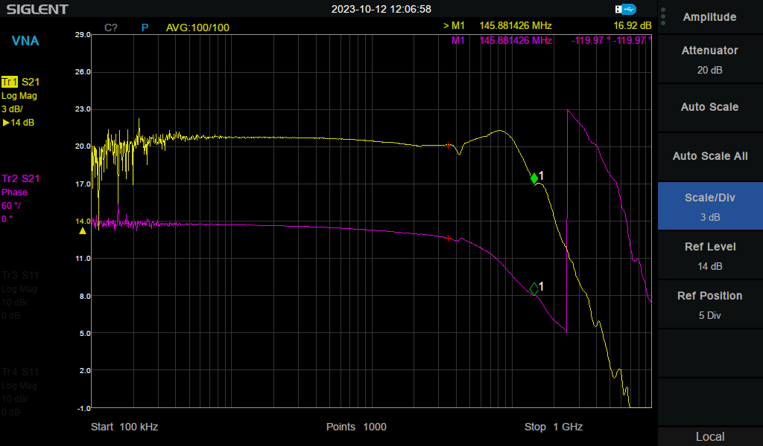
S21 Measurements (Differential Mode, Probe has gain x10)

Slide 6
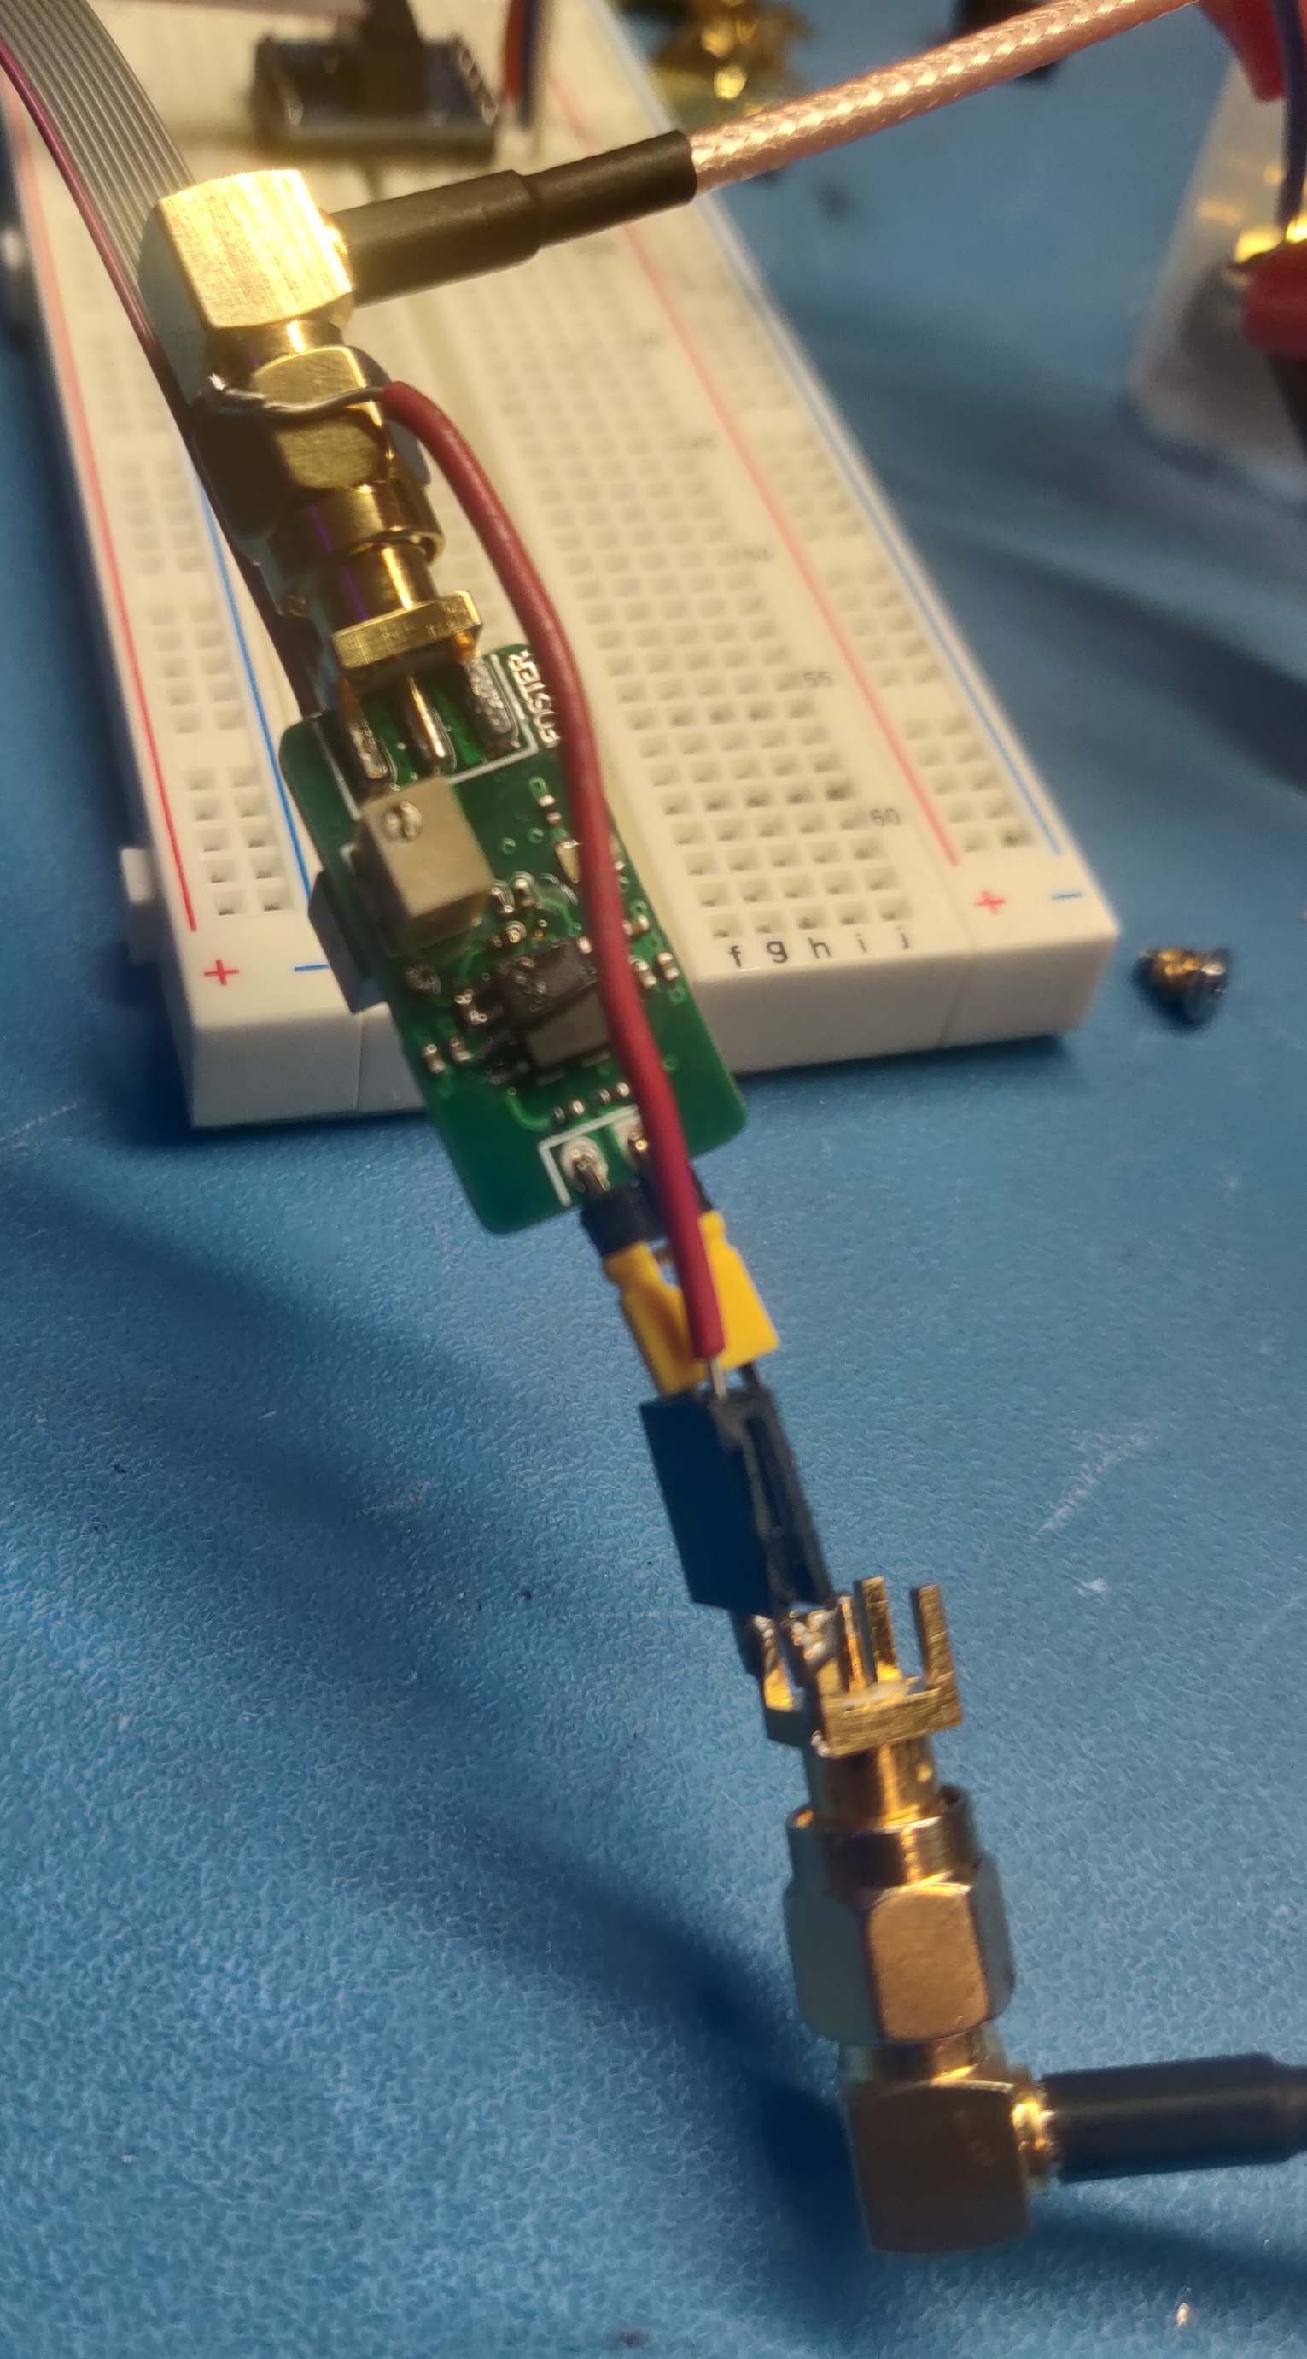
Measurement Setup for Common Mode Test
Probe Power
Network Analyzer (Port 2)
GND connection between port 1 & port 2
Shorted inputs using jumper
Network Analyzer (Port 1)

Slide 7
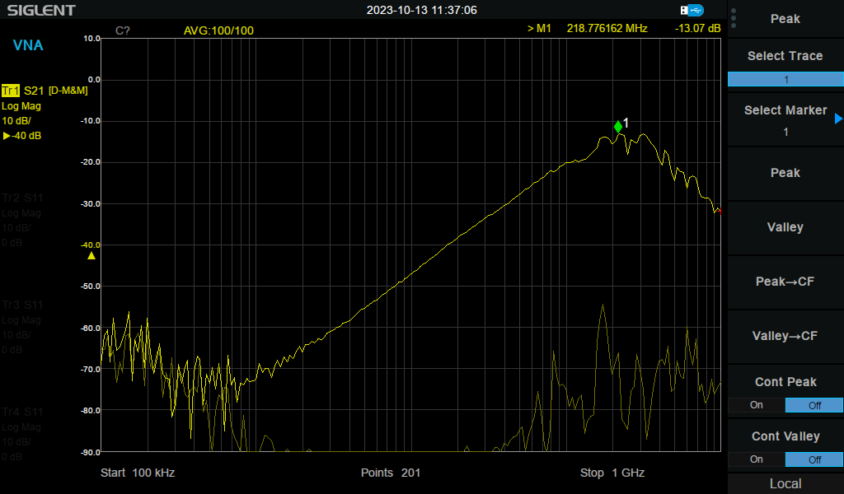
S21 Measurements (Common Mode)
Network analyzer configured to display: (Probe CMRR – Instrument Noise Floor)
Noise floor of instrument

